Slide 1
Secure Data Hiding in Images Using Steganography
CAPSTONE PROJECT
Presented By:
Student Name : Ayan Mondal
College Name & Department : Netaji Subhash Engineering College | Computer Science & Engineering

Slide 2
OUTLINE
Problem Statement
Technology used
Wow factor
End users
Result
Conclusion
Git-hub Link
Future scope

Slide 3
Problem Statement
In today's digital world, secure communication is at risk due to cyber threats and surveillance. Traditional encryption protects data but makes its presence obvious, increasing the chance of interception. There is a need for a method that not only encrypts sensitive information but also conceals its existence. This ensures confidential communication without raising suspicion.

Slide 4
Technology used
Programming Language
Python – Core language for implementing the steganography and encryption logic.
Libraries & Frameworks
OpenCV – For image processing and manipulation.
NumPy – For efficient handling of image data as arrays.
PyCryptodome – For AES-256 encryption and decryption.
Base64 – For encoding encrypted data into a text format.
Hashlib – For generating secure encryption keys using SHA-256.

Slide 5
Wow factors
Dual-Layer Security: Combines LSB steganography with AES-256 encryption, ensuring both secrecy and security. Most steganography tools only hide data, but StegoAES also encrypts it, making unauthorized access nearly impossible.
Lossless Data Concealment: Uses PNG images to maintain image quality while embedding secret messages, unlike JPEG-based methods that risk data loss due to compression.
Custom Encryption & Decoding Keys: Requires a unique steganography key to extract hidden data and an AES decryption key to unlock the message, adding an extra security layer.
Lightweight & Open-Source: No need for heavy dependencies—just Python and a few libraries. Easily customizable and extendable for further improvements.

Slide 6
End users
Privacy Enthusiasts & Individuals – People who want to communicate securely without raising suspicion.
Journalists & Activists – Those who need to share sensitive information while avoiding censorship or surveillance.
Cybersecurity Professionals – Experts working on secure data transmission and encryption techniques.
Law Enforcement & Intelligence Agencies – For covert communication and secure information exchange.
Researchers & Academics – Individuals studying cryptography, steganography, or data security.
Developers & Ethical Hackers – Those interested in integrating or improving steganographic security solutions.
Organizations & Businesses – Companies needing confidential watermarking, hidden metadata, or secure internal communication.

Slide 7
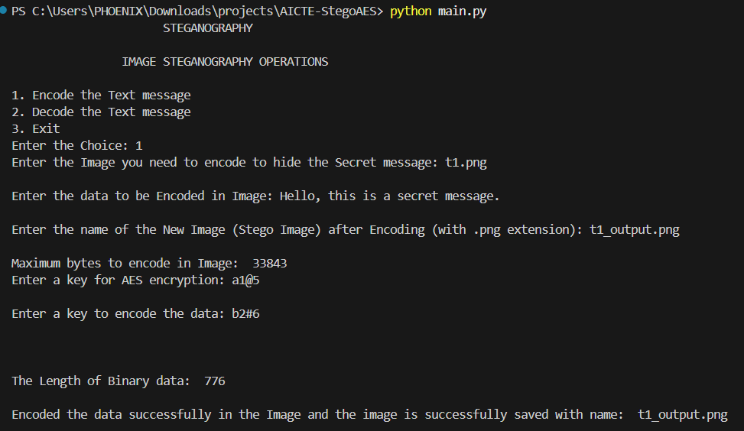
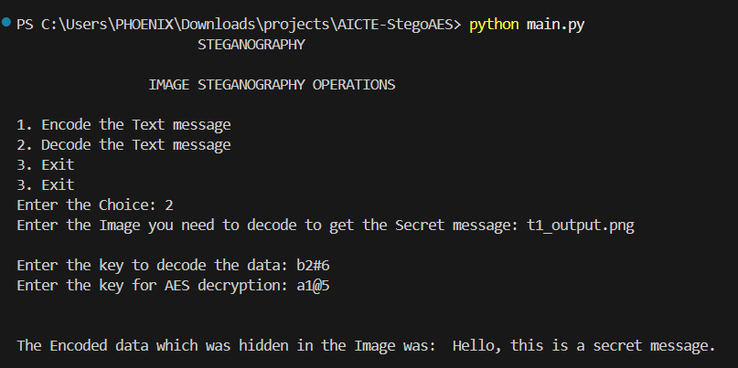
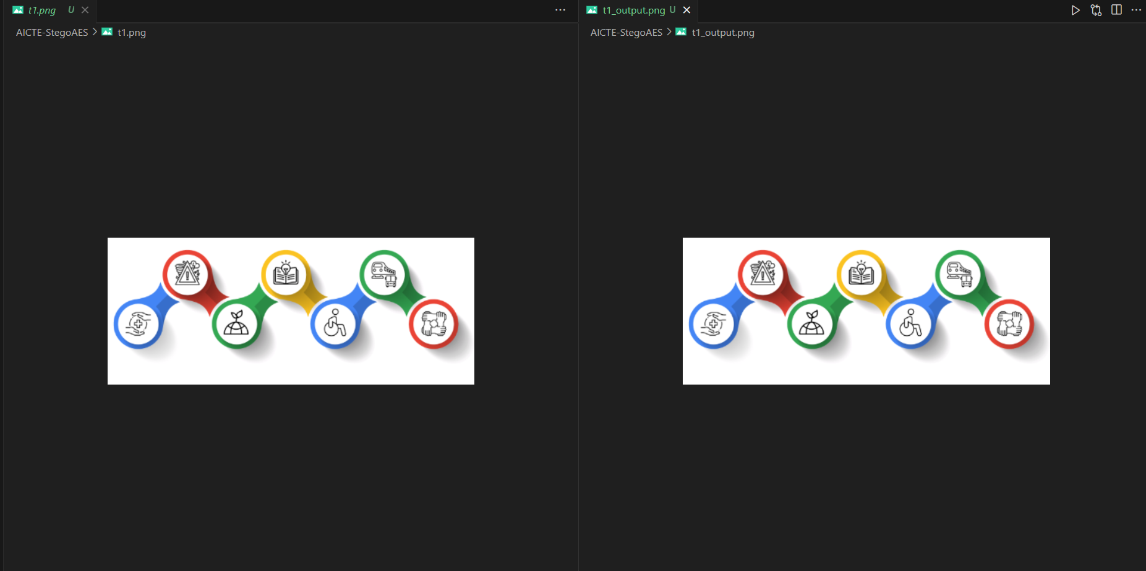
Results
Google Drive: Link

Slide 8
Conclusion
In an era where digital privacy is increasingly threatened, StegoAES provides a powerful solution for secure and discreet communication. By integrating LSB steganography with AES-256 encryption, it ensures that sensitive information is not only hidden within images but also securely encrypted, preventing unauthorized access. Unlike traditional encryption methods that expose the presence of confidential data, StegoAES conceals it, making detection nearly impossible. This project serves as a reliable tool for individuals and organizations seeking enhanced privacy, secure data exchange, and digital watermarking. With its robust security, user-friendly CLI, and lossless data embedding, StegoAES stands out as an effective and practical solution for modern-day secure communication needs.

Slide 9
GitHub Link
GitHub: https://github.com/trinetra110/AICTE-StegoAES

Slide 10
Future scope(optional)
Improved Compression & Storage Efficiency: Implement advanced compression techniques to store larger messages within smaller image sizes without compromising security.
Enhanced Encryption Algorithms: Introduce additional encryption options, such as RSA, to provide users with more flexibility in securing their messages.
Steganalysis Resistance: Develop countermeasures to make the hidden data even harder to detect by advanced steganalysis techniques.
Graphical User Interface (GUI): Build an easy-to-use desktop or web application for non-technical users to encode and decode messages visually.
Video & Audio Steganography: Extend functionality to hide encrypted messages within video and audio files, increasing versatility for secure communication.
Blockchain Integration: Explore the possibility of embedding hidden messages in blockchain transactions for ultra-secure, decentralized communication.
Mobile Application Development: Create Android and iOS apps to make secure steganography accessible on mobile devices.

Slide 11
THANK YOU

